Slide 1
I Have Results!
Can you trust on them?
- Diogo Pacheco -

Slide 2
Outline
Why?
How?
What?

Slide 3
Why?

Slide 4
Confirmation Bias

Slide 5
Hindsight Bias

Slide 6
Proposal
Can we use social media data to understand society?
Can we use online footprints to characterize users?
We proposed a methodology to characterize users based on the frequency of attention given to a set of entities.
Users ~ entities relationships

Slide 7
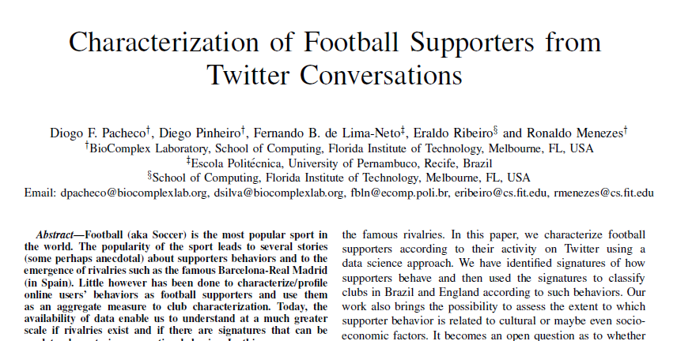

Slide 8
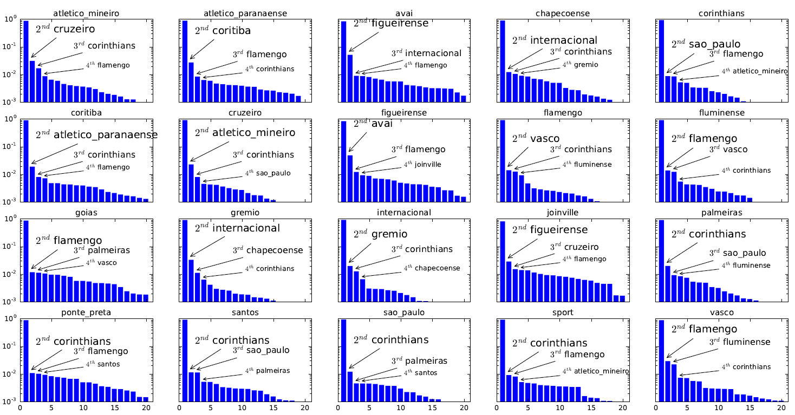

Slide 9
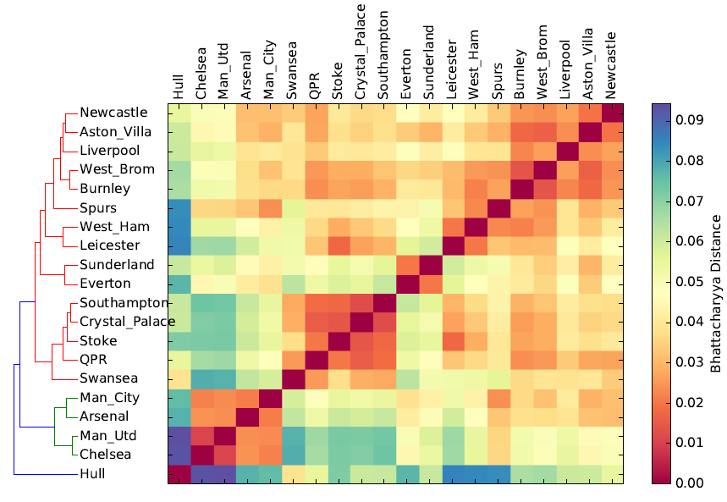

Slide 10
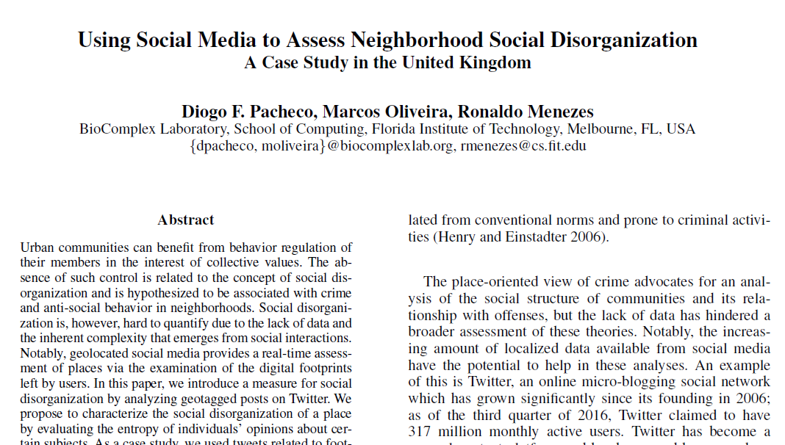

Slide 11
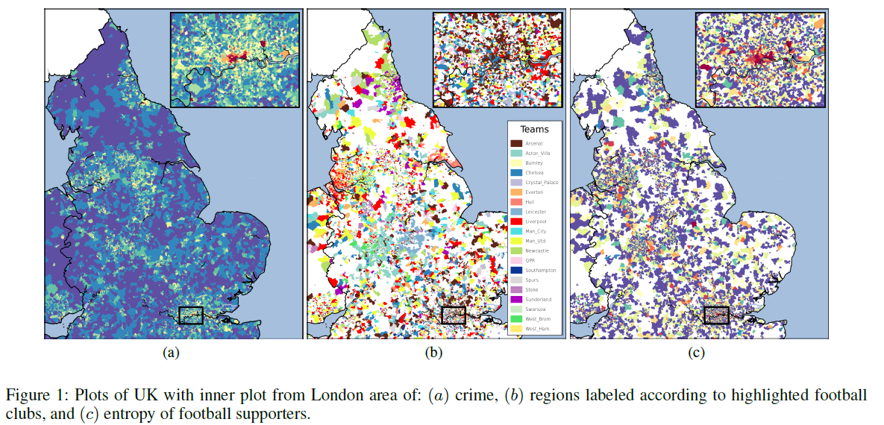

Slide 12
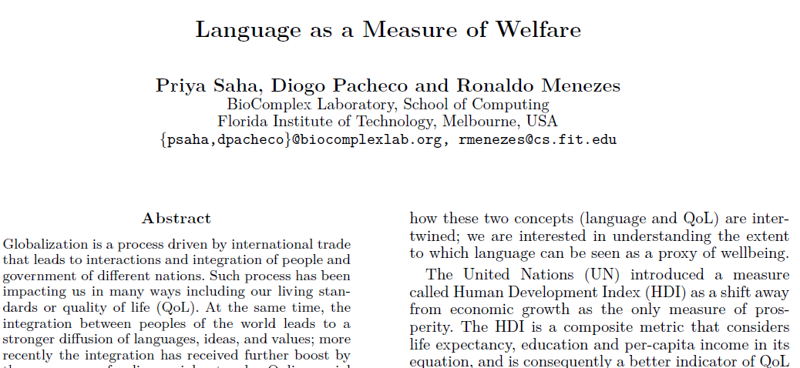

Slide 13
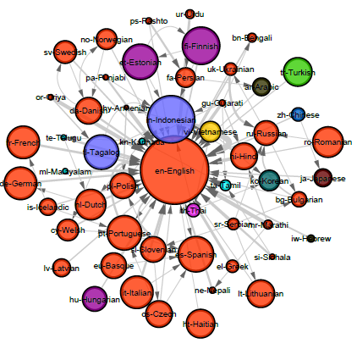
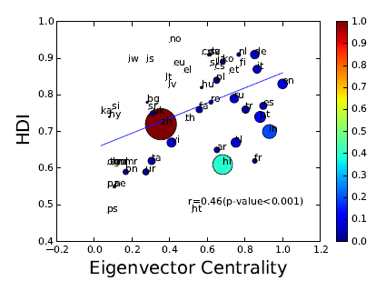

Slide 14
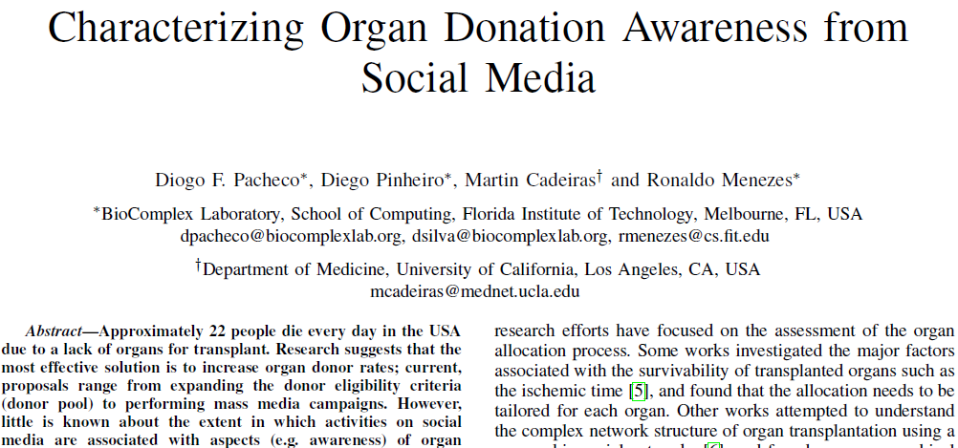

Slide 15
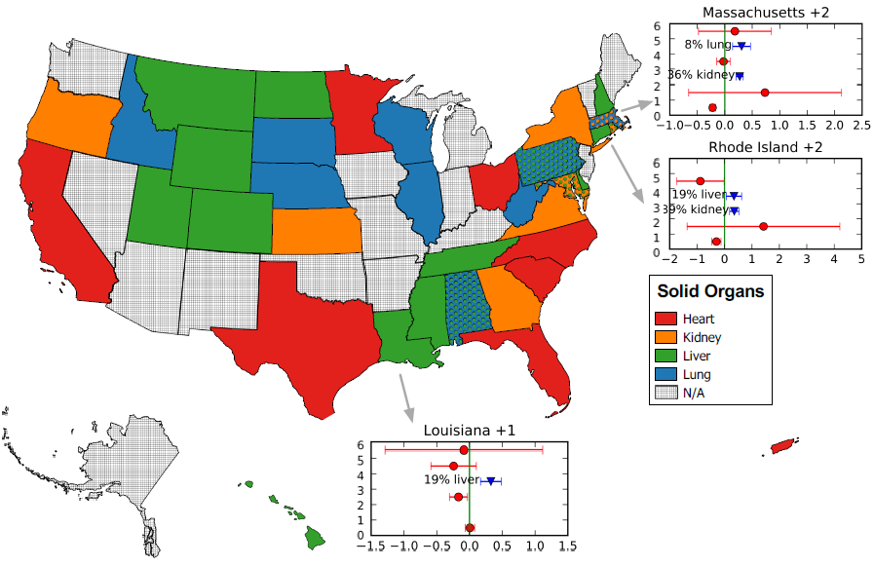

Slide 16
How?

Slide 17
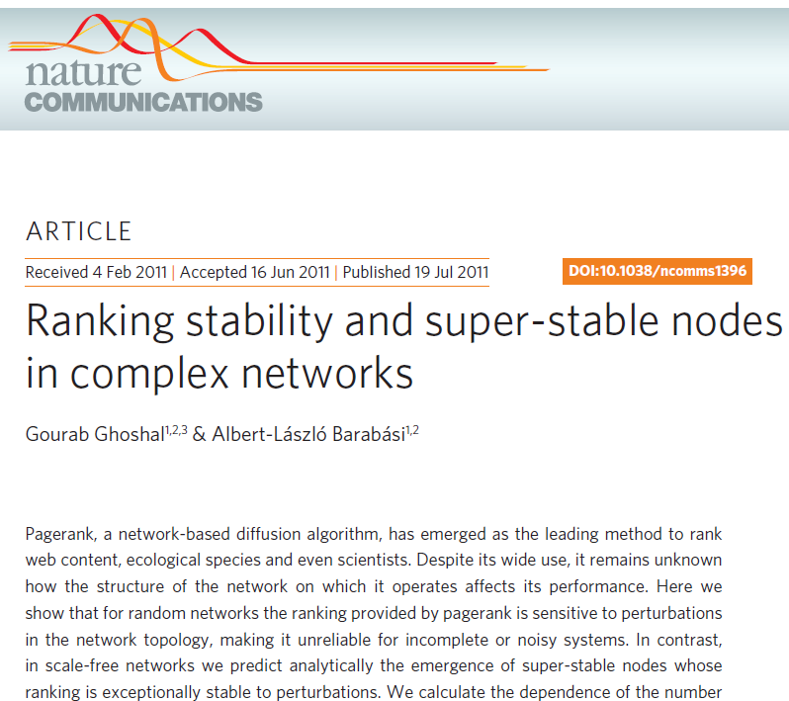

Slide 18
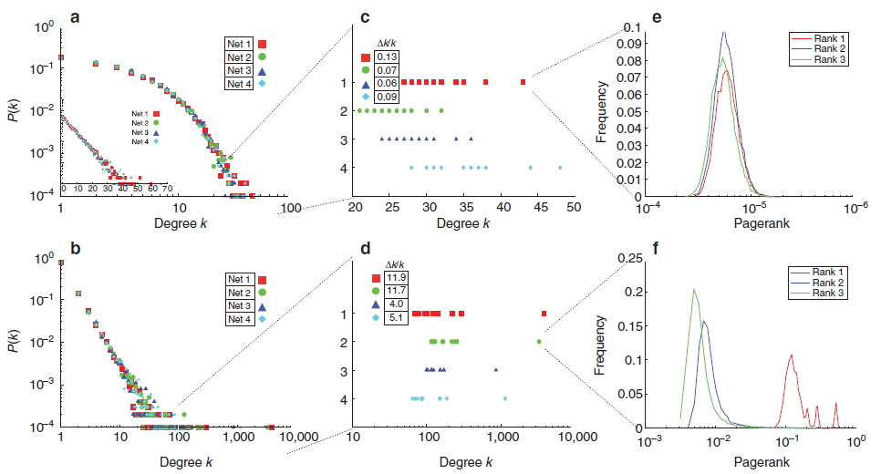

Slide 19
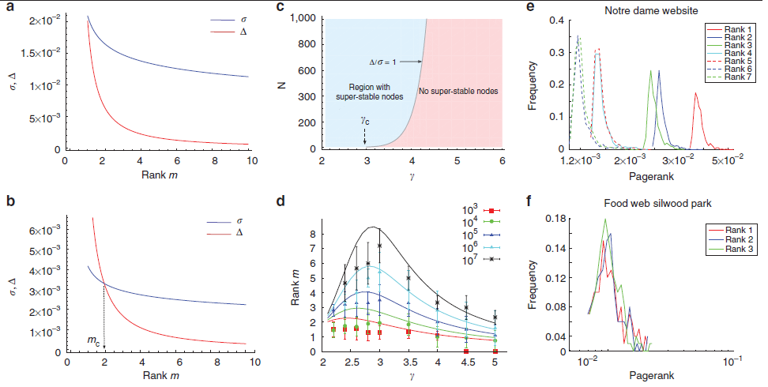

Slide 20
What?

Slide 21
How much data to characterize a user?
Can I trust on user’s preference?
How many users to characterize entities?
Is that true for all datasets?

Slide 22
Dataset: Brazilian Football
28 Mi Tweets
1 Mi Users
425 Tracked Entities (Clubs)
Previously: 20 clubs, 70 languages, and 6 organs.

Slide 23
Exploratory Analysis
Patterns
Data validation

Slide 24
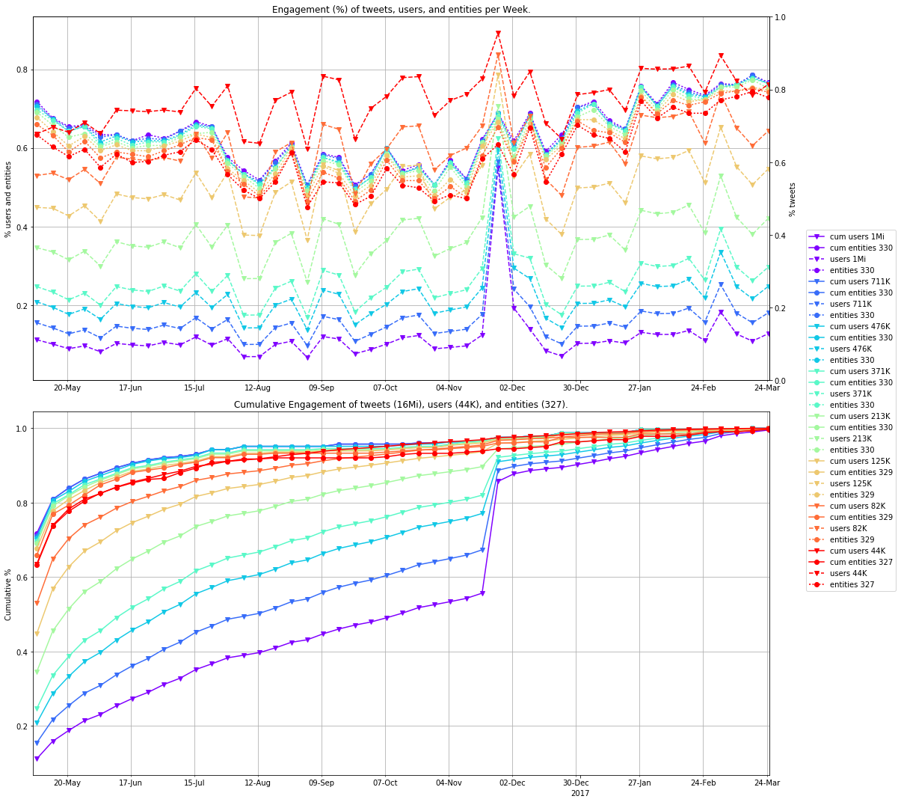
Min Tweets:
1
3
5
7
15
30
50
100
Users
Entities
Filter: min #tweets (colors)

Slide 25
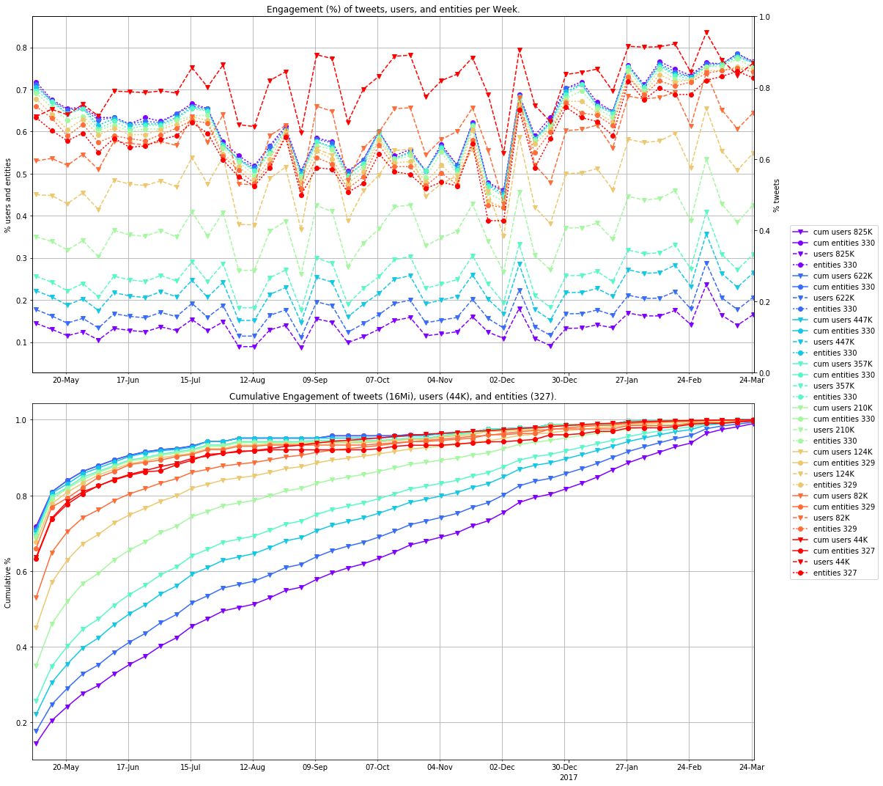
Min Tweets:
1
3
5
7
15
30
50
100
Users
Entities
Filter: min #tweets (colors)

Slide 28
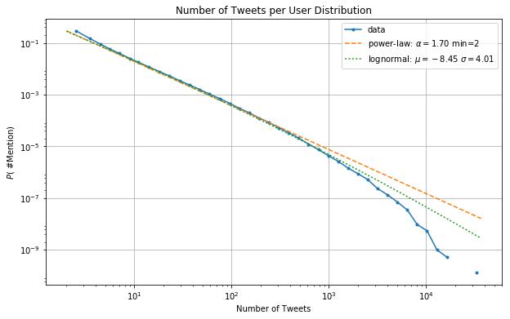

Slide 29
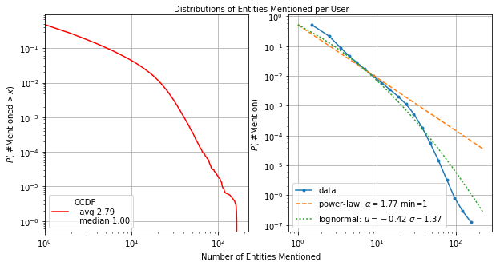

Slide 30
User Analysis
Checking our characterization
Very different behaviors
Stable ≠ Invariant

Slide 31
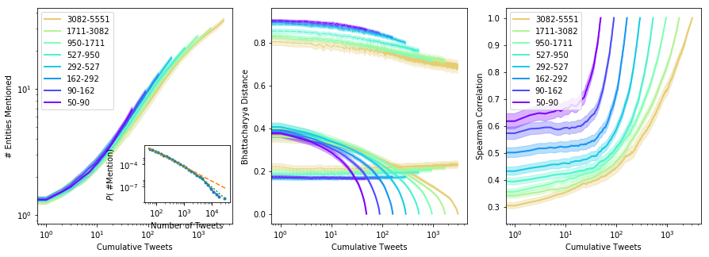
Sample of 500 users per group

Slide 32
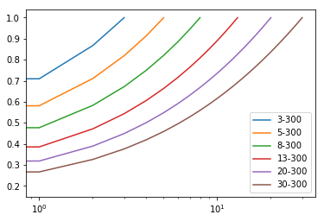
Sample of 500 users per group
1222222222...
1233333333...
1234444444...
1234555555...
1234566666...

Slide 37
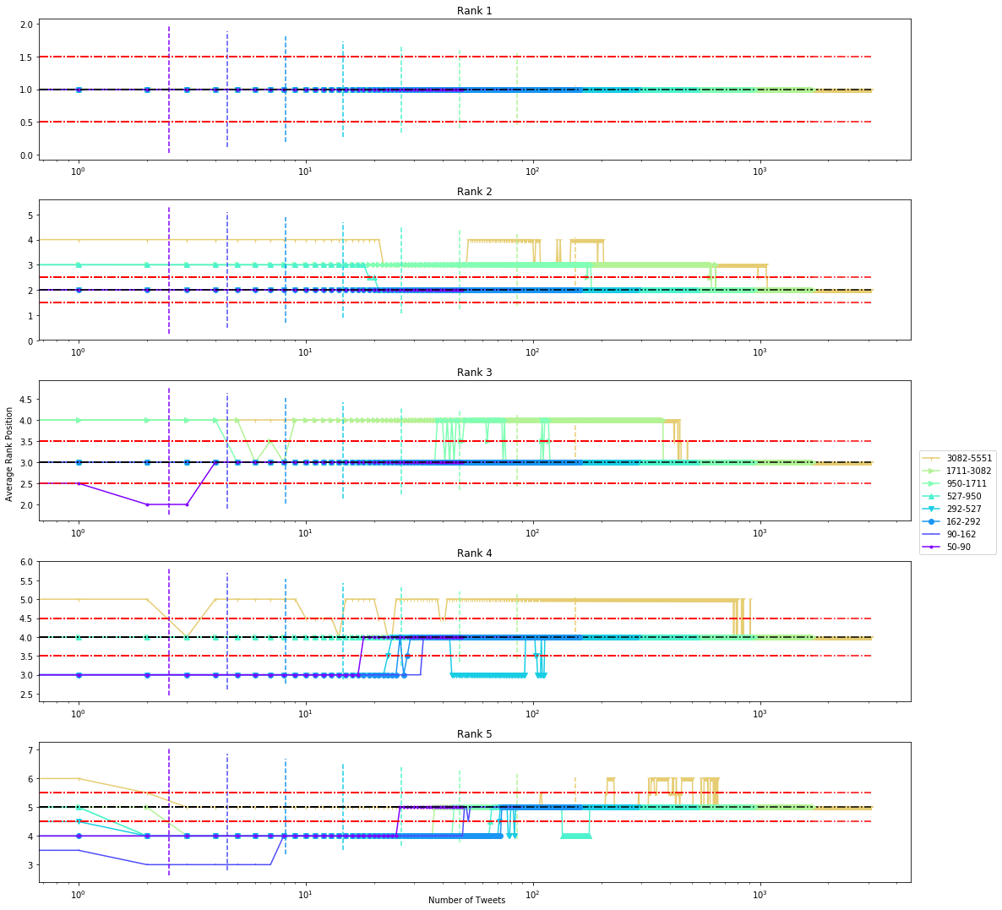

Slide 38
Different users: avg(R1) – avg(R2)...
Same user: avg(R1 – R2)...

Slide 39
Entity (Aggregation) Analysis
What is expected when we aggregate “instability”?
More instability or the emergence of stability?

Slide 40
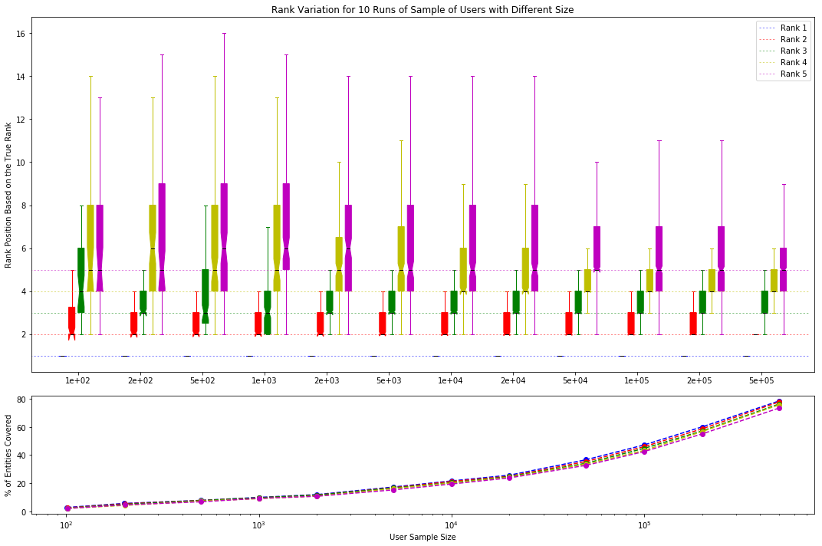

Slide 42
Summary
Be vigilant, don’t forget hindsight and confirmation biases.
Check whether or data make sense (exploratory analysis).
Bhattacharya distance X Spearman correlation
Most users have 1st and 2nd rank positions stable
The user sample sizes influence more on #entities than in their quality.
Further analysis on temporal effects because of Chapecoense.
Replicate to other datasets.

Slide 43
Questions?

